Slide 1
Sales Dataset Analysis – Advanced Excel Project
Aswin Raj V.p

Slide 2
Project Overview & Objectives
Project Objective:"To analyze sales data to identify trends, understand sales performance, and provide actionable business insights.“
Goals:
Analyze sales trends over time.
Identify high-performing products and sales channels.
Determine the impact of discounts.
Create a dynamic dashboard with key metrics.

Slide 3
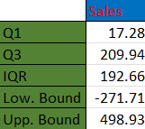
Data Description and Preparation
Dataset Overview:
A dataset with approximately 10,000 rows, including columns like Order ID,Customer ID, Product Type, Sales Amount, etc.
Data Cleaning Process:
Data formatting for consistency (dates, currency, etc.)
Removal of duplicates
Handling missing values
Filtering Outliers

Slide 4
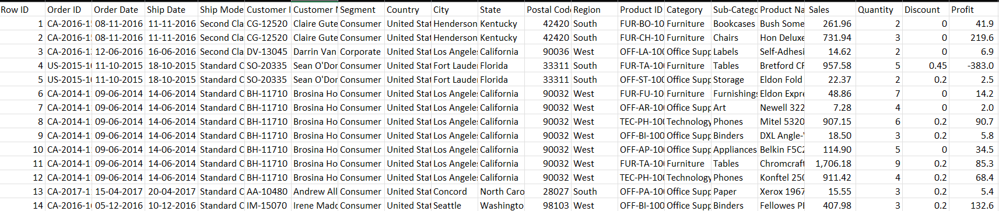
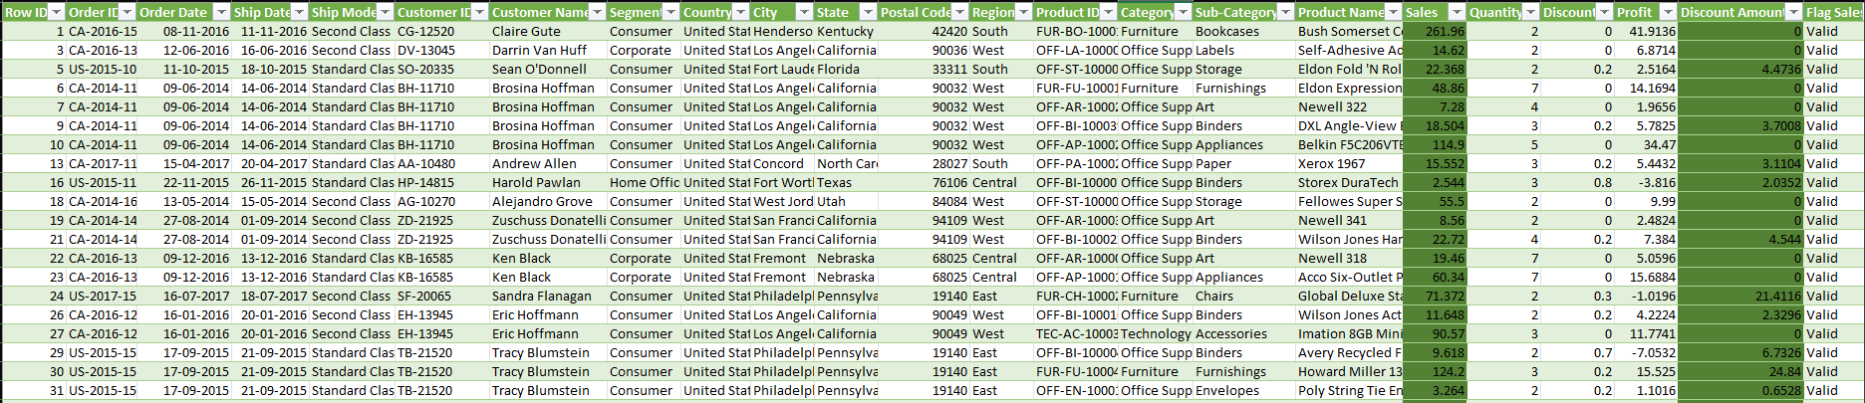

Slide 5
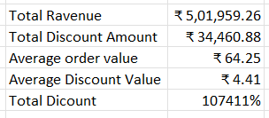
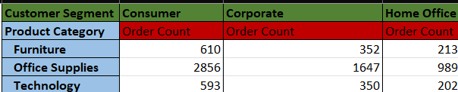
Key Metrics Calculation and Data Analysis
Important Calculations:
Total Sales (Gross, Net, Adjusted)
Average Sales Per Order
Discount
Sales by Product

Slide 6
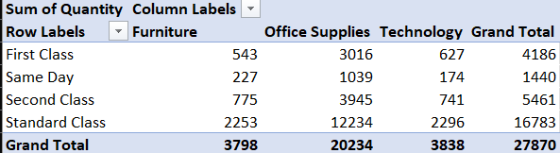
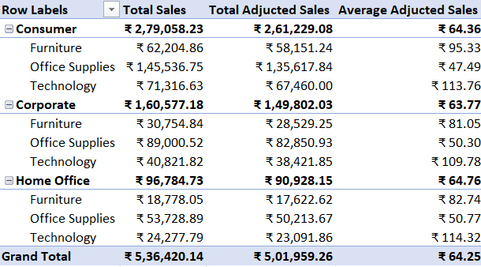
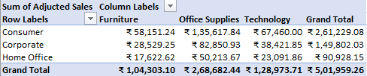
Pivot Tables and Pivot Charts
Pivot Tables were used to aggregate sales data by key dimensions
Enabled deeper insights into sales trends and performance
PivotCharts helped visualize trends in sales
Identifying peak sales months or analyzing sales by product category

Slide 7
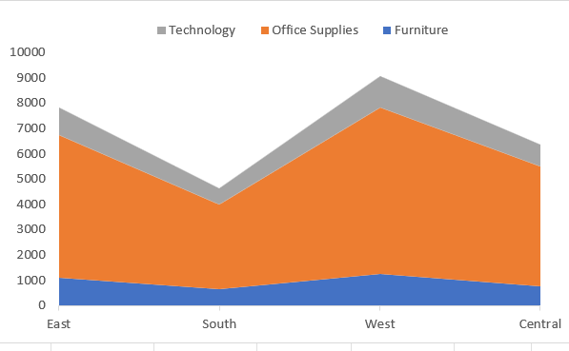
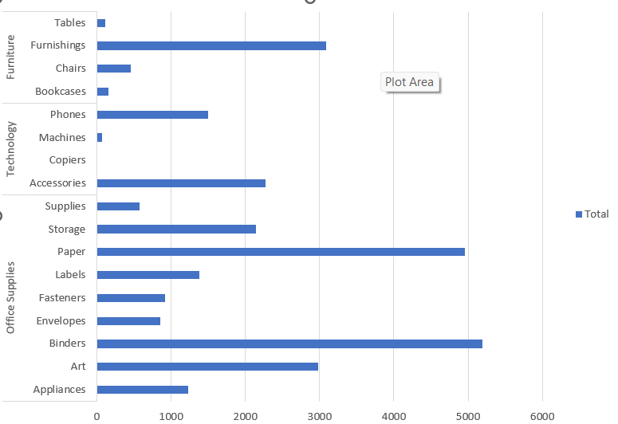
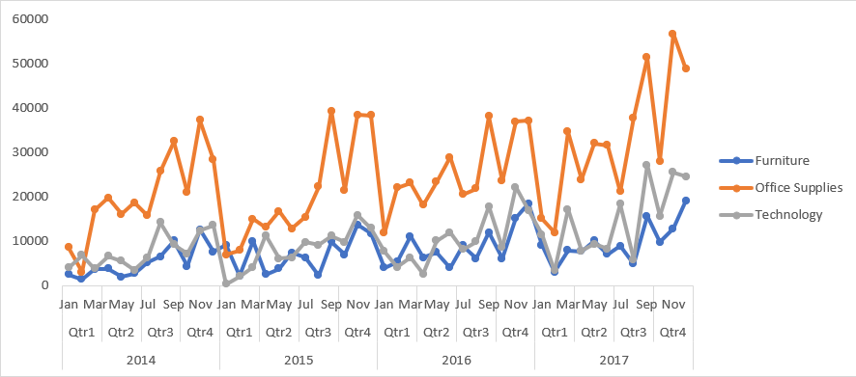

Slide 8
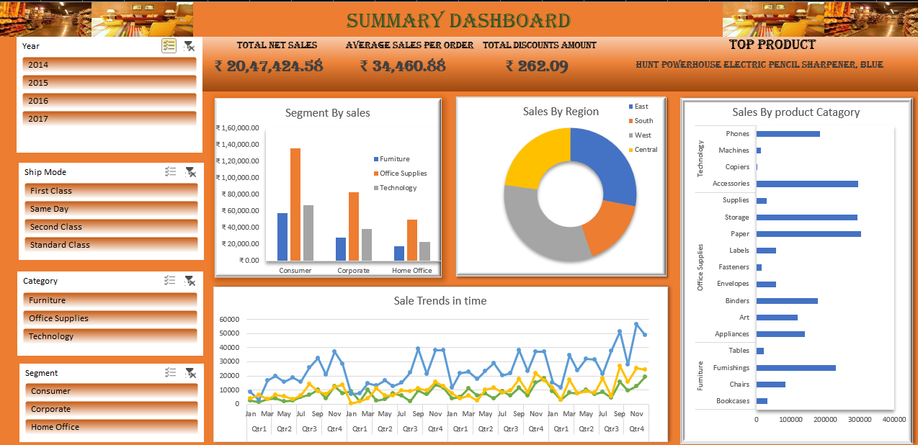
Dashboard Overview

Slide 9
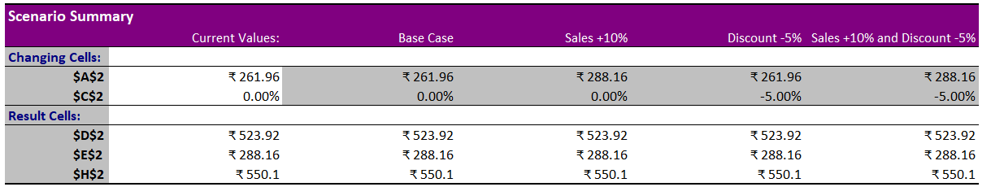

What-If Analysis & Goal Seek
Used Goal Seek
What-If Scenarios:
Sales Increase Simulation
10% increase in sales
5% discount increase

Slide 10
Macros
Automate repetitive tasks, like formatting cells, performing calculations, and generating reports.
Formatting Data – Applied bold, font changes, borders, and background colors to specific ranges.
Automating repetitive tasks with macros saves valuable time, allowing more focus on analysis and decision-making.

Slide 11
Insights and Recommendations
Office Supplies is the highest revenue-generating category
Furniture shows a significant growth percentage, but this should be further analyzed for its sustainability.
Sales are highest in Q4, especially for certain product categories.
Since Consumer sales contribute the highest revenue.
Since there’s a noticeable difference in the sales of categories across customer segments
Technology might be more popular during the holiday season, so you could offer discounts during peak times to boost sales.

Slide 12
Conclusion
Identified significant sales trends,
Analyzed sales performance
Evaluated the impact of discounts on sales
Extracted actionable insights

Slide 13
Thank You

